Slide 1

PERSONAL medical history DATABASE MANAGEMENT
IDEATHON-CSI DAY
BY ANMOL MUNNOLLI
SEM 3
BRANCH:ISE

Slide 2


AN OVERVIEW- PERSONAL MEDICAL HISTORY DATABASE MANAGEMENT
Goals of My Software:
EACH PERSON WILL HAVE A UNIVERSAL DATABASE WITH AN UNIQUE ID TO KEEP TRACK OF HIS/HER HEALTH AND PAST CLINICAL RECORDS.
EVERY PERSON WILL HAVE EASY ACCESS TO HIS/HER MEDICAL HISTORY DATABASE, AND IS NOT ALWAYS DEPENDENT ON AN ORIGANIZATIONAL DATABASE.
SINCE THE DATABASE WILL BE UNIVERSAL, IT IS EASY FOR ANY MEDICAL PROFESSIONAL TO UNDERSTAND AND UPDATE PATIENT RECORDS
MEDICAL HISTORY TRANSPARENCY

Slide 3

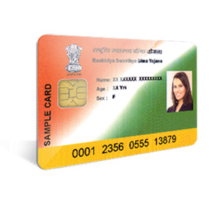
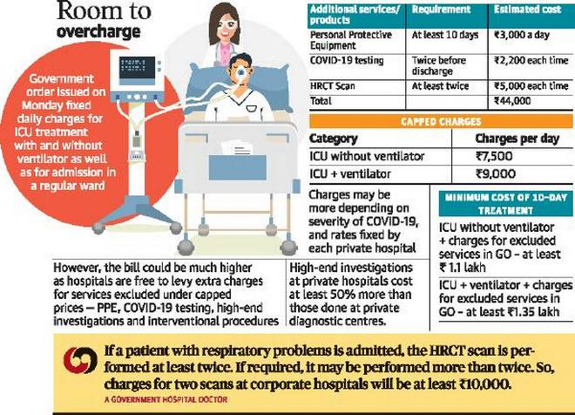

WHY THIS IDEA??
Each organization issues its own health card!!!
Its time we become Digital and Universal!!
Keep track of your medical expenses
Dont Know if your hospital is charging too much??
Lets make their actions universal!!

Slide 4
SOFTWARE
WEBSITE
RDBMS
APPLICATION

Slide 5
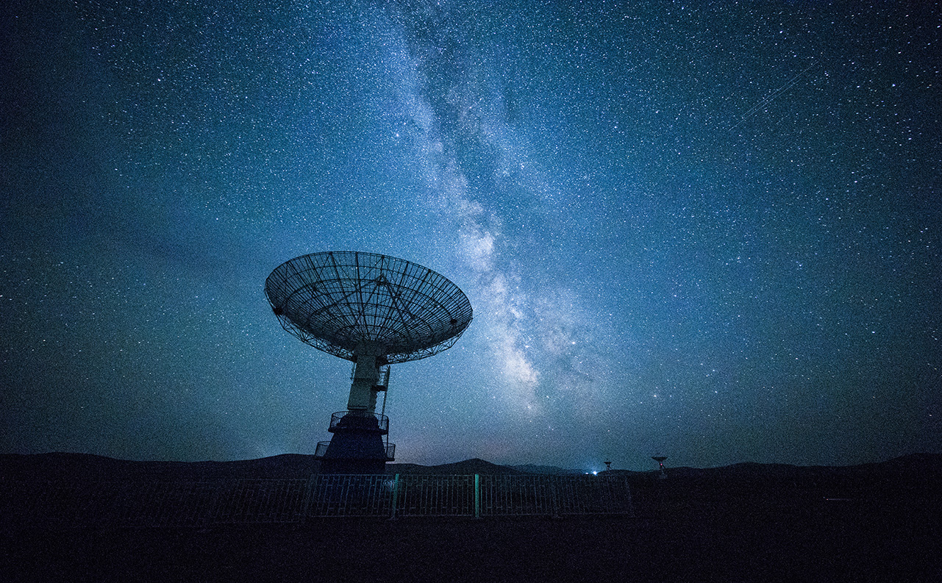
requirements
MySql
PHP
Excel
Python

Slide 6
LETS SEE HOW THIS SOFTWARE WORKS!

Slide 7
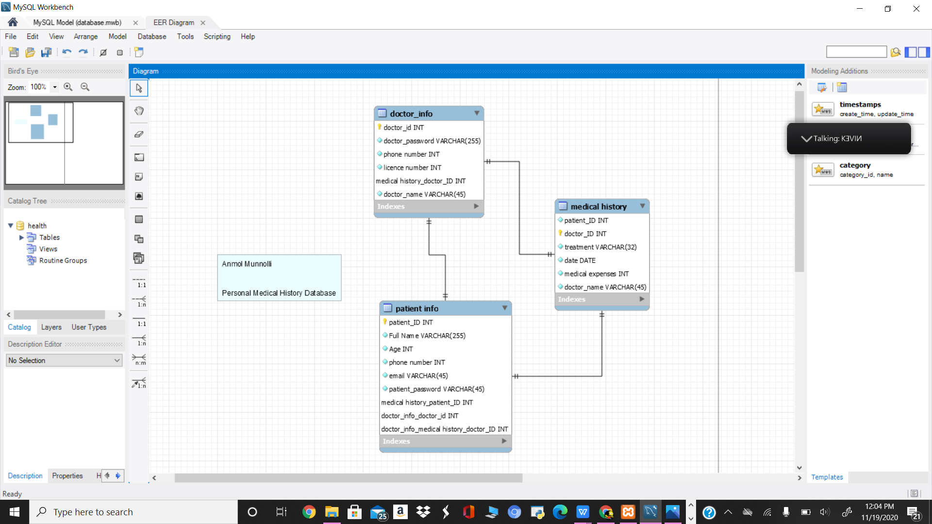

Slide 8
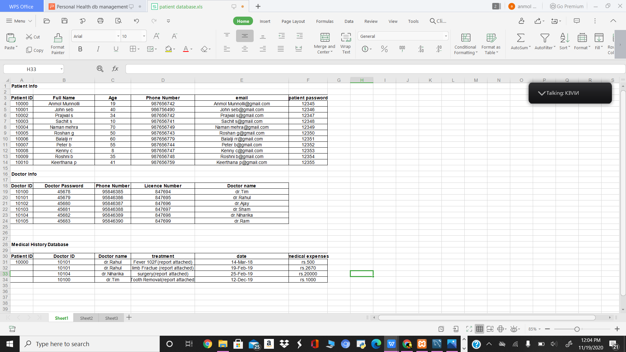

Slide 9
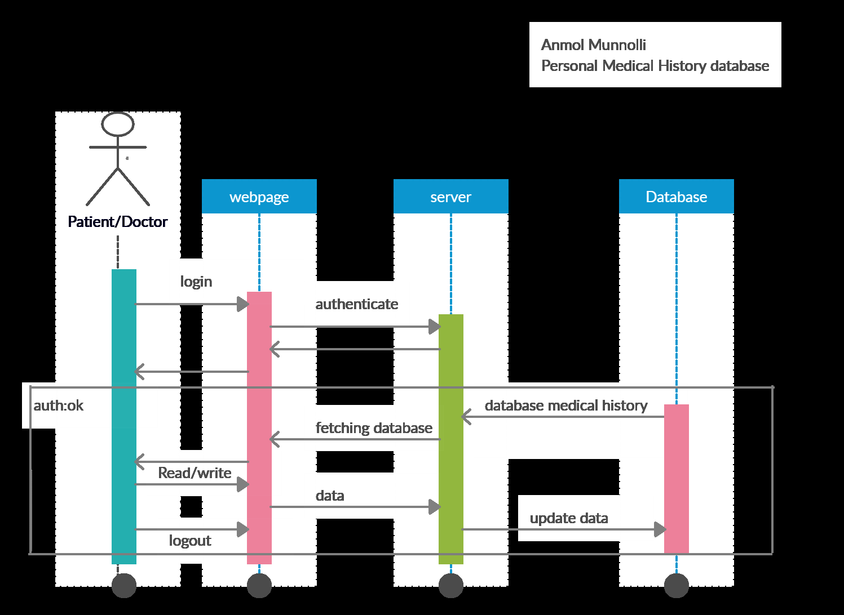

Slide 10

Thank You!
By:ANMOL MUNNOLLI
SEM 3
ISE BRANCH

